Slide 1
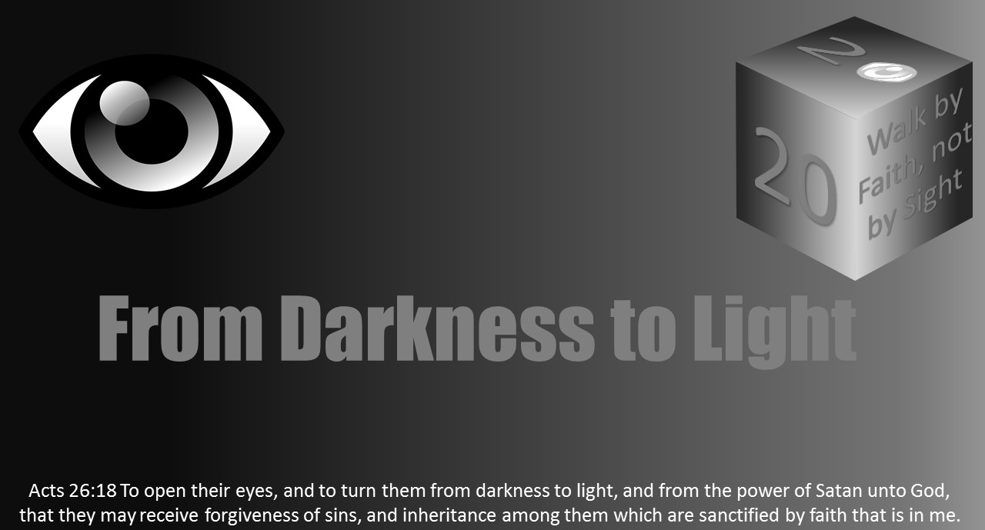


Slide 2

Light Lesson 11 Holiness: The Light of Heaven and God's Glory

Slide 3
Introduction
“And one cried to another and said: “Holy, holy, holy is the Lord of hosts; The whole earth is full of His glory!” (Isa 6:3).
“The four living creatures, each having six wings, were full of eyes around and within. And they do not rest day or night, saying: “Holy, holy, holy, Lord God Almighty, Who was and is and is to come!” (Rev 4:8)
God is the creator. God is eternal. God is immutable and unchanging. God is trustworthy. God is above human ways. God is just. God is omnipotent and omniscient. However, the first four characteristics many name to describe God are love, righteous, light, and holy. Holy is His permeating and transcendent quality. It encompasses everything. Holiness encompasses God’s divine nature, including his various attributes such as love, righteousness, and light.
Psalm 43:3 expresses it this way: “O send out thy light and thy truth: let them lead me; let them bring me unto thy holy hill, and to thy tabernacles.”

Slide 4
Defining Holy
Holy has two ideas when defining it.
The first is set apart from sin. Our Holy God is completely separated from sin! This idea is on the word hagios. God and all that He does are the total opposite of Satan and all that he does. (Jam 1:17; Tit 1:2; 1 John 1:5; Hab 1:12-13; Isa 6:1-7).
The second definition of “holy” refers to “a unique character that causes the reaction of reverence/honor.” (Moses at the burning bush; Exod 3:1-6).
God is honored in everything He does. (Sin destroyed [John 1:29]; Purchasing the church [Acts 20:28]; 1 Pet 2:9).

Slide 5
God is Holy
God is holy.
His heavenly dwelling is “holy” (Deut 26:15).
His throne is “holy” (Psalm47:8).
His name Is “holy” (Matt 6:9).
His Power is “holy” (Isa 52:10).
All His ways are “holy."

Slide 6
God is Holy
This is best seen in the crescendo of Revelation 4:1-11. For God to be holy is for Him to be holy in relation to every aspect of His nature and character.
When we use the word holy to describe God, we face another problem.
We often describe God by compiling a list of qualities or characteristics that we call attributes.
We say that God is a spirit, that He knows everything, that He is loving, just, merciful, gracious, and so on.

Slide 7
God is Holy
The tendency is to add the idea of God being holy to a long list of attributes, as one attribute among many.
However, when the word holy is applied to God, it does not signify one single attribute, but His nature.
God is called holy in an absolute sense. The word is used as a synonym for His deity.
“That is, the word holy calls attention to all that God is.
It reminds us His love is holy love, his justice is holy justice, his mercy is holy mercy, his knowledge is holy knowledge, his spirit is holy spirit.”

Slide 8
The Effect of God's Holiness
What should be our typical immediate reaction to God’s holiness is illustrated by John and Isaiah.
John reacts in Revelation 1:17, “And when I saw him, I fell at his feet as dead.”
The prophet Isaiah reacts similarly as recorded in Isaiah 6:5, “Woe is me! for I am undone; because I am a man of unclean lips.”
The responses are fear and awe yielding humility because of God’s holiness.
Is this our response?
Do we grasp that God is holy, holy, holy? What should be our response to God’s holiness?

Slide 9
The Effect of God's Holiness
Fear (reverence) drives us to humility.
Are we humbled when we come before Him?
What is our disposition to Him when we come before Him in worship, in prayer, in service?
All of these activities should involve complete humility, awe, reverence, and love.
It should truly be in spirit and in truth (John 4:24).

Slide 10
The Effect of God's Holiness
2 Samuel 6:1-11 also helps one understand how we should respond to God's holiness.
The holiness of God should guide and govern our thinking as well as our actions.
Uzzah’s intention may have been noble, but the action violated God’s command and attempted to breach His holiness.
The holiness of God needs to be considered when we speak of accountability.

Slide 11
The Effect of God's Holiness
Too often we are willing to accept our good intentions as being good enough.
The appropriate response to the holiness of God is fear (reverence), and the outworking of our fear is obedience.
The holiness of God is the basis and the compelling necessity for our sanctification.
James 4:8-10 admonishes us to draw near to God in humility purifying our hearts.

Slide 12

The Second Emphasis of Holy
The second emphasis of the term holy is absolute moral perfection.
This is tied to our understanding of God as light.
1 John 1:5 teaches, "God is light and in Him is no darkness at all."
To help us understand that God is light, think about how He has no shadow (James 1:17).
A light source will not create a shadow itself. A match struck with a light behind it will have a shadow, but the flame will not.
This state of moral perfection is impossible for us to achieve apart from God’s redemptive plan.
Without the purifying blood of Jesus, none of us would be able to approach God because of His holiness (Heb 9:13-14).

Slide 13
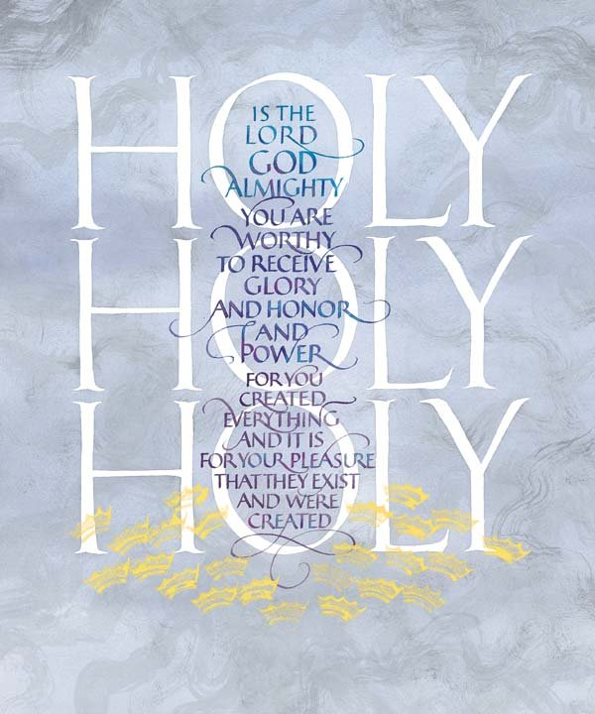
The Second Emphasis of Holy
Isaiah 6:1-5 reads, "In the year that king Uzziah died I saw also the Lord sitting upon a throne, high and lifted up, and his train filled the temple. Above it stood the seraphims: each one had six wings; with twain he covered his face, and with twain he covered his feet, and with twain he did fly. And one cried unto another, and said, Holy, holy, holy, is the LORD of hosts: the whole earth is full of his glory. And the posts of the door moved at the voice of him that cried, and the house was filled with smoke. Then said I, Woe is me! for I am undone; because I am a man of unclean lips, and I dwell in the midst of a people of unclean lips: for mine eyes have seen the King, the LORD of hosts."
This is a very real reaction to God's holiness. Too many claiming to see God have no sense of His holiness, and so their comments are clearly false.

Slide 14
The Second Emphasis of Holy
R.C. Sproul commented on Isaiah 6 and holiness by saying:
"The Bible says that God is holy, holy, holy. Not that He is merely holy, or even holy, holy. He is holy, holy, holy. The Bible never says that God is love, love, love, or mercy, mercy, mercy, or wrath, wrath, wrath, or justice, justice, justice. It does say that He is holy, holy, holy, the whole earth is full of His glory.”

Slide 15
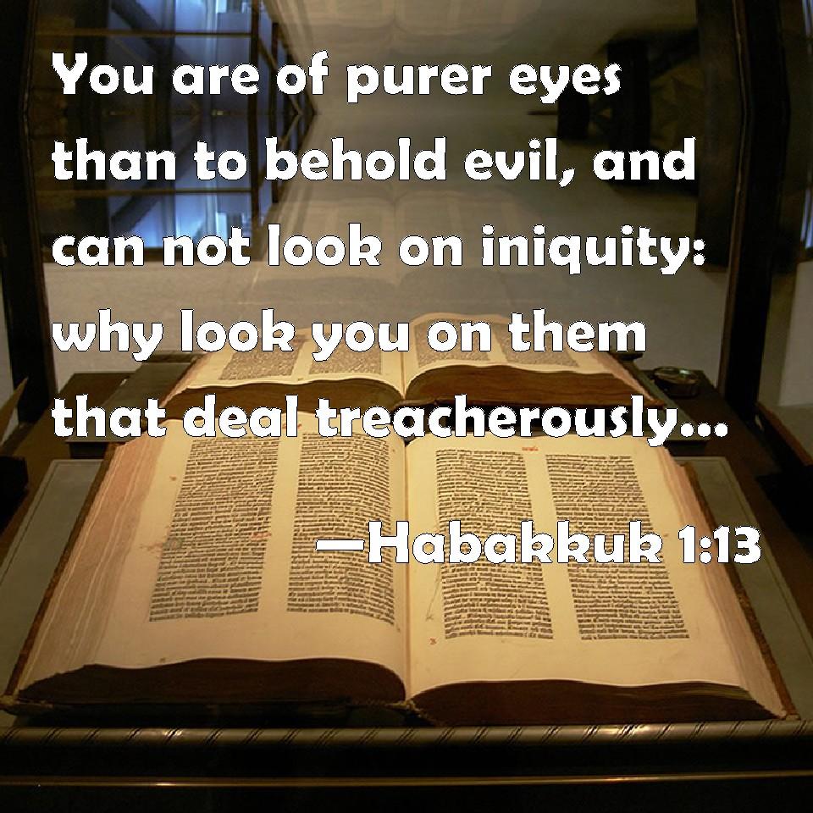
God's Wrath and Sin
Darkness (evil) is banished by the light of God.
The contrast is seen in the scriptures by God's settled opposition to sin.
He demonstrates His divine revulsion to evil. The only possible response from a Holy, Holy, Holy God!
Habakkuk 1:12-13 reads “Art thou not from everlasting, O LORD my God, mine Holy One? we shall not die. O LORD, thou hast ordained them for judgment; and, O mighty God, thou hast established them for correction. Thou art of purer eyes than to behold evil, and canst not look on iniquity: wherefore lookest thou upon them that deal treacherously, and holdest thy tongue when the wicked devoureth the man that is more righteous than he?”

Slide 16
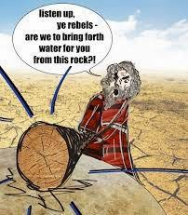
God's Wrath and Sin
Moses did not make it to the promise land because he did not demonstrate respect for God’s holiness. (God commanded the Israelites to be holy because He was holy in Leviticus 11:44, 45; 19:2; 20:26). Numbers 20:12 reads, "And the LORD spake unto Moses and Aaron, Because ye
believed me not, to sanctify me in the eyes of the children of Israel, therefore ye shall not bring this congregation into the land which I have given them." Moses, the great leader of God’s people, failed to reach the promise land because he tried to put his arm around God and say must “we” do this for you. Pride is dangerous, so God’s holiness should help us live in humility.

Slide 17
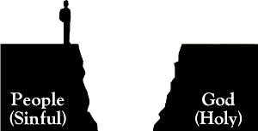
God's Wrath and Sin
What is sin's effect?
First, sin separates from God. Isaiah 59:1-2 teaches, "Behold, the LORD’S hand is not shortened, that it cannot save; neither his ear heavy, that it cannot hear: But your iniquities have separated between you and your God, and your sins have hid his face from you, that he will not hear."
Second, sin yields God’s wrath. Romans 1:18 reads, "For the wrath of God is revealed from heaven against all ungodliness and unrighteousness of men, who hold the truth in unrighteousness."

Slide 18
God's Wrath and Sin
Because sin separates us from God and brings God's wrath, Paul explains God's plan to save us in Romans 3:23-25.
“For all have sinned, and come short of the glory of God; Being justified freely by his grace through the redemption that is in Christ Jesus: Whom God hath set forth to be a propitiation through faith in his blood, to declare his righteousness for the remission of sins that are past, through the forbearance of God.”
Thus, despite the effects of sin, we are still called to be holy!

Slide 19
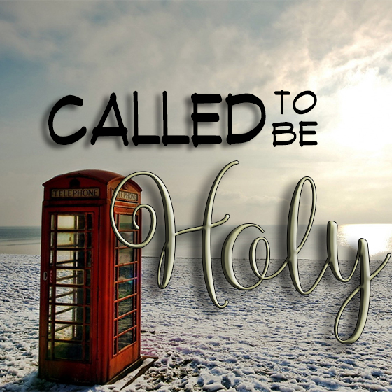
God's Calls for the Church to Be Holy
The message is clear. God has called Christians into holiness. We are to be like Him.
This causes us to ask: How can we be holy as He is holy? The idea of being holy is clearly directive and commanded, not some mere suggestion.
1 Peter 2:9-10 teaches, "But ye are a chosen generation, a royal priesthood, an holy nation, a peculiar people; that ye should shew forth the praises of him who hath called you out of darkness into his marvellous light: Which in time past were not a people, but are now the people of God: which had not obtained mercy, but now have obtained mercy."

Slide 20

God's Calls for the Church to Be Holy
Ephesians 1:4-7 reads, “According as he hath chosen us in him before the foundation of the world, that we should be holy and without blame before him in love: Having predestinated us unto the adoption of children by Jesus Christ to himself, according to the good pleasure of his will, To the praise of the glory of his grace, wherein he hath made us accepted in the beloved. In whom we have redemption through his blood, the forgiveness of sins, according to the riches of his grace."

Slide 21
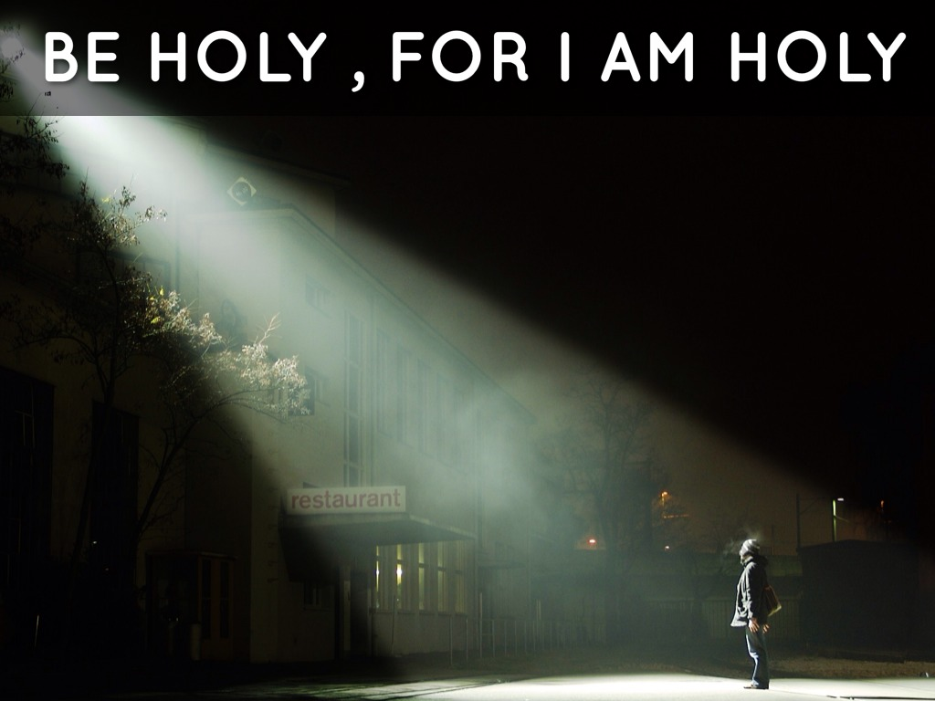
God's Calls for the Church to Be Holy
This is where our study of darkness and light fits in a discussion of holiness.
Christians have been called out of darkness to walk as children of light, carrying the light and being holy. (See also 1 John 1:7-10).
1 Peter 1:13-16 communicates, “Wherefore gird up the loins of your mind, be sober, and hope to the end for the grace that is to be brought unto you at the revelation of Jesus Christ; As obedient children, not fashioning yourselves according to the former lusts in your ignorance: But as he which hath called you is holy, so be ye holy in all manner of conversation; Because it is written, Be ye holy; for I am holy.”

Slide 22
God's Calls for the Church to Be Holy
2 Peter 2:3-4 further notes that children of the Light become partakers of the divine nature. "According as his divine power hath given unto us all things that pertain unto life and godliness, through the knowledge of him that hath called us to glory and virtue: Whereby are given unto us exceeding great and precious promises: that by these ye might be partakers of the divine nature, having escaped the corruption that is in the world through lust."

Slide 23
God's Calls for the Church to Be Holy
The Hebrews writer in 10:19-22 teaches, "Having therefore, brethren, boldness to enter into the holiest by the blood of Jesus, By a new and living way, which he hath consecrated for us, through the veil, that is to say, his flesh; And having an high priest over the house of God; Let us draw near with a true heart in full assurance of faith, having our hearts sprinkled from an evil conscience, and our bodies washed with pure water."
The point is Christians are made holy in Jesus Christ! Children of Light are called to a life of holiness, out of darkness.
2 Corinthians 7:1 reads, "Having therefore these promises, dearly beloved, let us cleanse ourselves from all filthiness of the flesh and spirit, perfecting holiness in the fear of God." The ESV translates the text, "Since we have these promises, beloved, let us cleanse ourselves from every defilement of body and spirit, bringing holiness to completion in the fear of God."

Slide 24
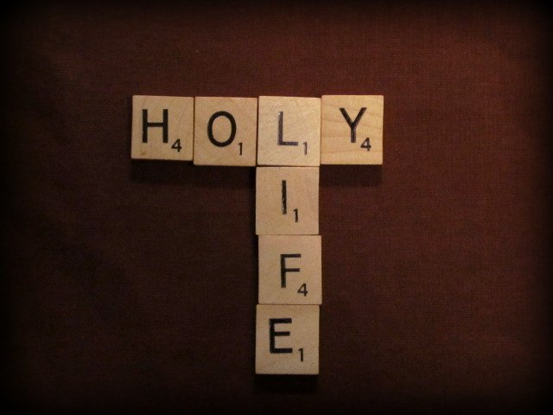
God's Calls for the Church to Be Holy
Clearly because of God's revulsion to sin (holiness),
Christians must be sanctified.
1 Thessalonians 4:3-8 explains, "For this is the will of God, even your sanctification, that ye should abstain from fornication: That every one of you should know how to possess his vessel in sanctification and honour; Not in the lust of concupiscence, even as the Gentiles which know not God: That no man go beyond and defraud his brother in any matter: because that the Lord is the avenger of all such, as we also have forewarned you and testified. For God hath not called us unto uncleanness, but unto holiness. He therefore that despiseth, despiseth not man, but God, who hath also given unto us his holy Spirit."

Slide 25
God's Calls for the Church to Be Holy
Holiness makes a difference in how we live our daily lives.
God sees our sins.
Sin separates us from God.
God expects us to practice self-control and put away sin and uncleanliness.
God expects us to transform to offer a living and holy sacrifice that is acceptable through Christ with our lives (Rom 12:1-2).
God calls us to be holy as He is holy.
Living holy as Christ did begins with opening our thinking to truth and continues with an ongoing renewal process from God’s word.
Christians are renewed in study, meditation, prayer, and penitence.
To be partakers of God’s holiness, Christians must start with humility. (See also Rom 12:3; Eph 4:1-3; Phil 2:3-4; Col 3:12-13; 1 Pet5:5; and Acts 20:18-19).

Slide 26
Conclusion
God is holy, holy, holy!
God is unique, separate, sacred, and physically unapproachable.
His holiness should humble us, cause us to have reverence and awe in our worship and prayer, and impact our daily walk in His light.
Further, God is absolute moral perfection.

Slide 27

Conclusion
God is opposed to sin because He is holy.
Sin separates us from God, bringing His wrath.
However, we are called to be holy as partakers of the divine nature, to put away former lusts, to carry the true light of Christ to the lost as we walk in the light.

